Slide 1
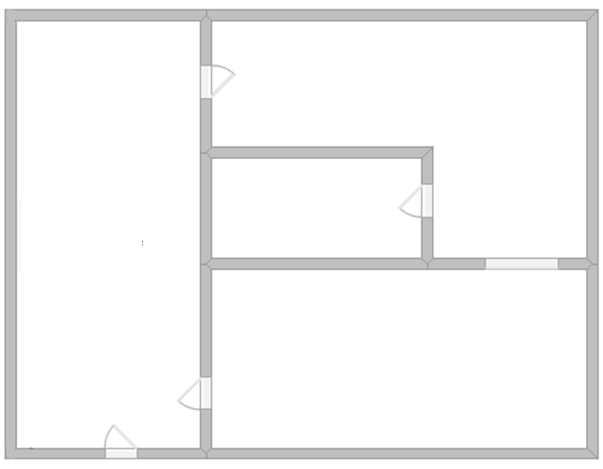
Problem solving with estimation and rounding
Task A: Problem solving with estimation
1) Here is a scaled drawing of a ground floor house. Given the dimensions, can you work out an estimate for the missing dimensions? Show your working out.
34.68 m²
…… m
33.62 m²
……… m²
32.32 m²
13.83 m

Slide 2
Problem solving with estimation and rounding
Task B: Problem solving with error intervals
1) A rectangle has a square removed from the centre.
Work out the error interval for the shaded area.
0.8 cm (to 1 d.p.)
1.4 cm
(to 1 d.p.)
4 cm (to 1 s.f.)
Task C: Using Fermi estimation
1) How much rubbish in tonnes does the UK produce every year? (without a calculator)
Hint - If you don’t have data to hand, think about how much your household throws away each week.

Slide 3
Problem solving with estimation and rounding
2) How many pennies would it take to make a stack the height of the Statue of Liberty? (without a calculator)
Hint - If you don’t know the thickness of a penny, measure one.
3) How many tennis balls can fit into your bedroom?
Mathematics in Education and Industry
v2.3

